Slide 1
Snatching a Positive from the jaws of a negative
(229) Adelinda 2020 June 17
Tony George IOTA 2020 Conference

Slide 2
The Event
The Observers:
Tony George
Paul Maley
Wayne Thomas
Richard Nolthenius
Phil Stuart (unlisted on Occult Watcher)
Mag Drop = 0.39
Duration = 8.4 sec

Slide 3
The ‘inconclusive’ observation that started the ball rolling
Tony George’s light curve.
The light curve from the first analysis is very ragged. View was over the roof of my house after a 108-deg day in Scottsdale, AZ.
After reviewing this light curve I declared my observation ‘inconclusive’.
I had a clear ‘event’ in the light curve and it passed the PyOTE false positive test, but it looked funny and I didn’t want to report it.
[Later, as part of the review process, I found out I had 3DNR turned on my camera causing the very odd looking light curve!]
I did Adelinda – my results are ‘inconclusive’. I got a 10 second event with only 0.15 mag drop, which does not match the predicted event – too long duration and too small mag drop. Also, there were other ‘dips’ in the light curve making me suspicious that the event was spurious, even though it passed the False Positive test. My light curve is attached. Looks like a miss to me. There is another chord report filed, closer to centerline, showing a miss. Looks like all misses to me.

Slide 4
Phil stuart to The RescuE
Phil Stuart writes:
Hey Tony:
I saw where you weren't happy with your Adelinda observation last night. I didn't sign up for it because I really wasn't sure I'd be successful after my Eunike fiasco plus my line was almost perfectly on top of yours. I did get something that looks a little like an event. It was long, though, like you said your event was in your comment in OccultWatcher. I got 9.48 seconds +/-2.34 seconds at 95%. I'm curious how long you came up with. I've attached my plot.
PHil
My response:
Interesting Phil. I had 10.6 seconds, but only a 0.15 mag drop. What was your mag drop? Shoot me a copy of your .log file so I can compare D and R times. My .log file is attached.
Tony George

Slide 5
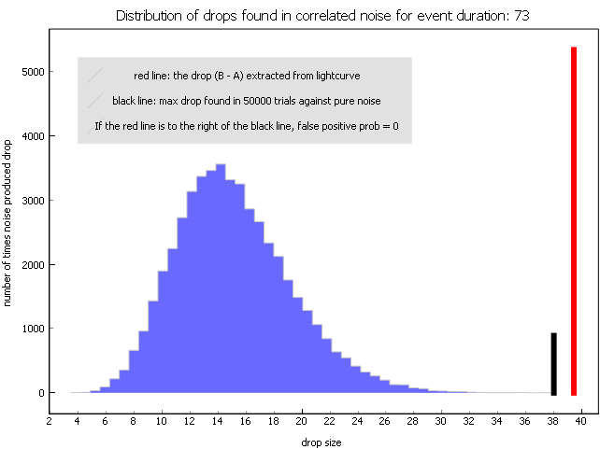
Phil’s Light curve
Phil sent me his .csv file. While noisy, Phil’s light curve clearly shows an event. His measured mag drop was 0.33, close to the predicted 0.39. PyOTE finds an event that passes the False Positive test.
This is our first positive.
It would have been unreported except for my ‘inconclusive’ report.

Slide 6
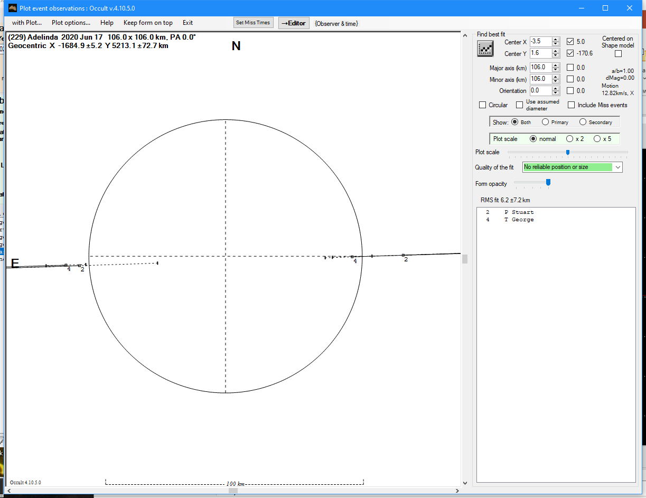
The test
After Phil’s message, I compared our two ‘chords’ in Occult4 by plotting the profile plot of our two chords to see if they remotely matched up.
Mine is Chord 4
Phil’s is Chord 2
Both chords match within error bars.
That makes two positive chords!

Slide 7
Now what?
Two co-located positive chords do not make for a positive event. We need more corroboration. Unfortunately, two other observers in the path reported MISSES. We needed to check the other chords.
Richard Nolthenius report to follow
George and Stuart positive chords
Paul Maley chord reported miss based on my analysis
Wayne Thomas chord reported miss
Time to check Paul and Wayne’s chords ….

Slide 8
Paul’s chord was checked – the result was inconclusive
Paul,
I have done an extensive reanalysis of your Adelinda event video. I still find your results ‘inconclusive’. I think I may have indicated earlier that your results indicated a ‘miss’, however that is an erroneous conclusion for the following reasons:
All PyOTE analyses indicate ‘No event found’
The mean background in your video is 140, very high due to the high degree of integration and apparently bright background sky.
The pixels in your target star are saturated. This is a result of the high degree of integration. With most of the brighter star pixels saturated, trying to find a low-mag-drop event is virtually impossible, since most of the mag drop is lost in the pixel saturation.
Sorry I could not find an event in your data. You should have had an event, but we need to defocus more in these highly integrated observations. I think now that you know how to check for pixel saturation in IOTA Video Capture, that should help.
Tony George

Slide 9
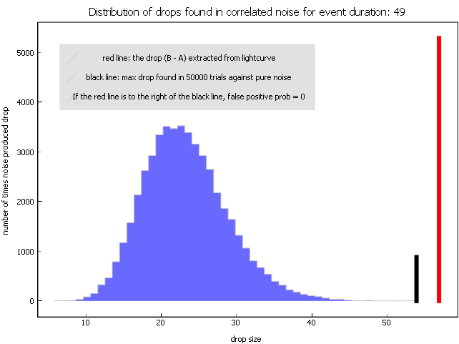
Wayne’s chord Checked – now positive
Wayne’s initial analysis was done using Limovie. I requested that Wayne send me his video so I could do an independent check with PyMovie. I was able to find a positive event.
Measured mag drop = 0.52
Lager than 0.39 predicted
It passed the PyOTE false positive test.

Slide 10
How does wayne’s chord fit the profile?
Very well!

Slide 11
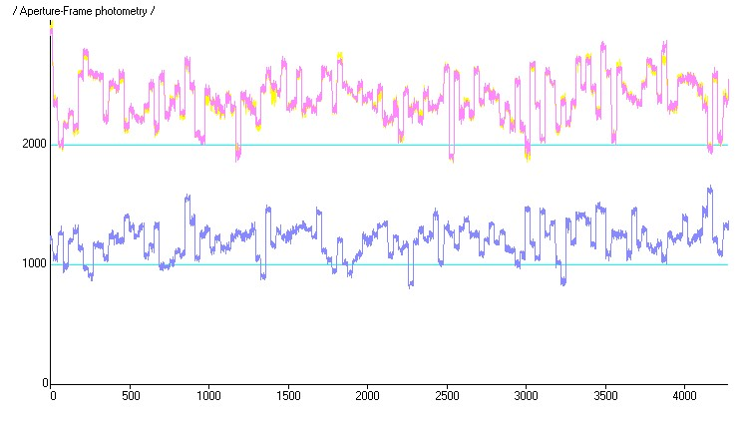
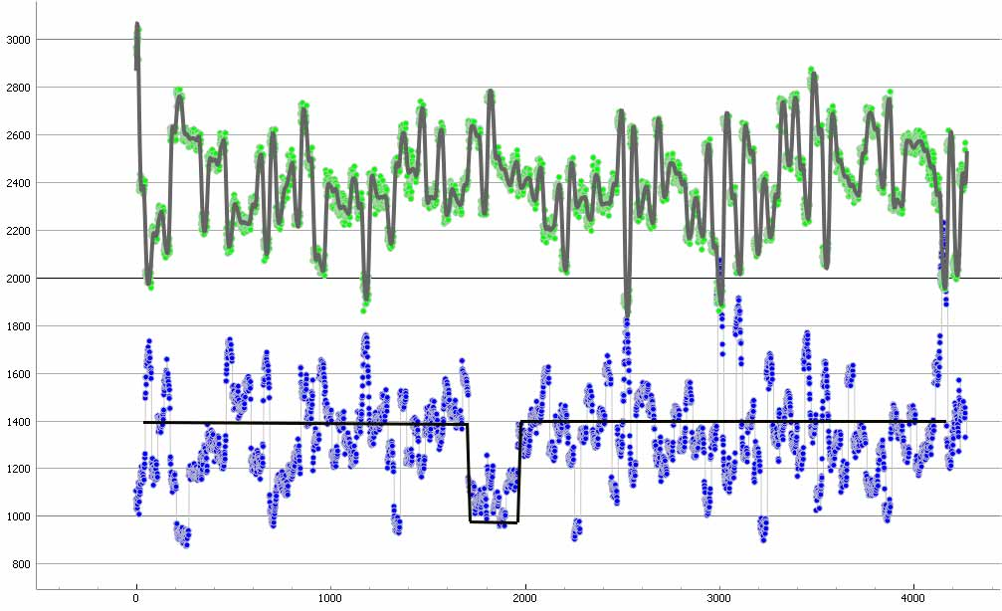
Richard’s chord
Richard Nolthenius felt he had a positive event but until others reported positive, he was unsure. So, I reported to Richard:
Richard,
I just did an independent analysis of Wayne Thomas’s video for which he previously reported a miss and I found a positive with D 4 seconds late, just like my observation. It was 6.8 seconds in duration, indicating that if you did get an event, it is likely shorter than 5 seconds. FYI.
Tony George
Scottsdale, AZ
Now, with information that his possible event fits with other observations, he files a positive report.
Richard’s raw light curve above. Expanded with presumed event below.
Richard adds his site to
OccultWatcher
Richard’s final light curve normalized to secondary star in PyOTE.
Event is more ‘visible’. Black event curve is manually drawn.

Slide 12
Richards ‘event’ fits with other positive chords
Adding Richard’s ‘positive’ yields a new profile at left.
The fit is quite good. Supports the assessment that Richard’s event is ‘positive’.

Slide 13
We now have ‘four’ reported chords snatched from inconclusive/negative to positive!
Each observation on its own might have been doubtful, I know mine was. However when Phil’s and my chords both agreed, they corroborated a positive. Then Wayne’s chord, also a positive, also agreed and corroborated our chords. Finally, Richard’s chord, which on it’s own was negative, or inconclusive at best, had a ‘blip’ in it that agrees with the other positive chords and therefore was included in the overall positive reports.
Moral to the Story – Write complete descriptions when entering a ‘No Observation’ report
From Phil Stuart: I think the Adelinda observation is a good argument for describing an observation in the "Report Observation" dialog when it's iffy. There's not much room available but if Tony had only said "No observation" and left it at that I wouldn't have noticed the similarity in our results.

Slide 14
Thanks
Thanks to all the observers for contributing their observations and exposing them to intense scrutiny. Also for their review of this presentation.
Paul Maley
Wayne Thomas
Richard Nolthenius
Phil Stuart (unlisted on Occult Watcher)
Also thanks to John Moore for his patience in trying to get this all sorted out over an extended period of time.

